Slide 1


Slide 2



Slide 3




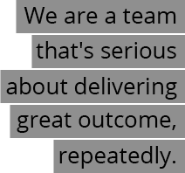

Slide 4

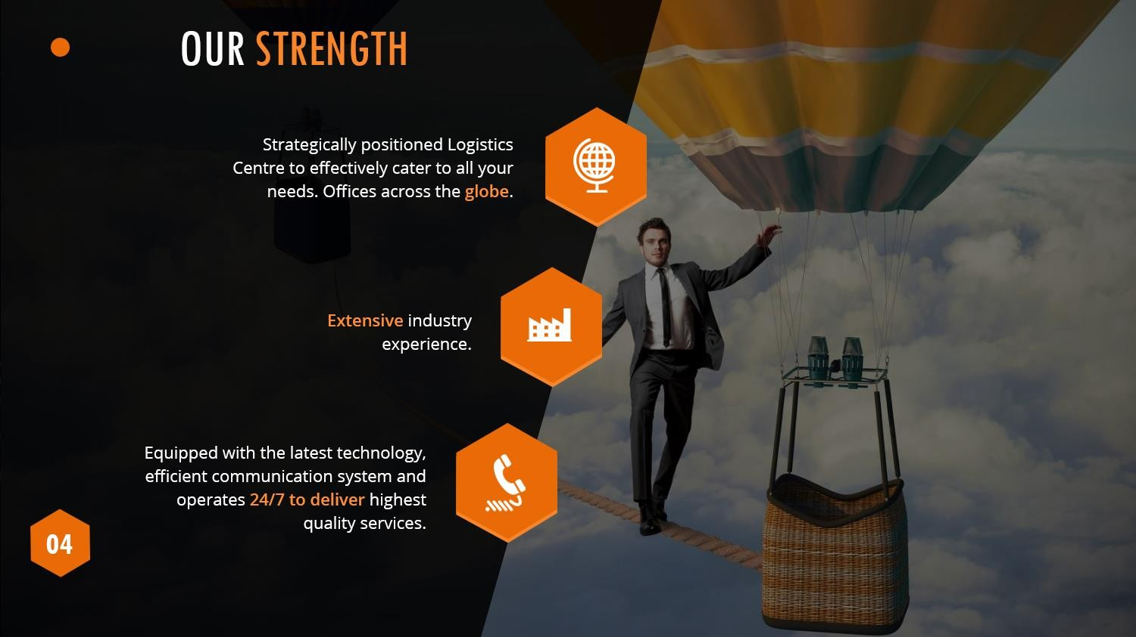

Slide 5
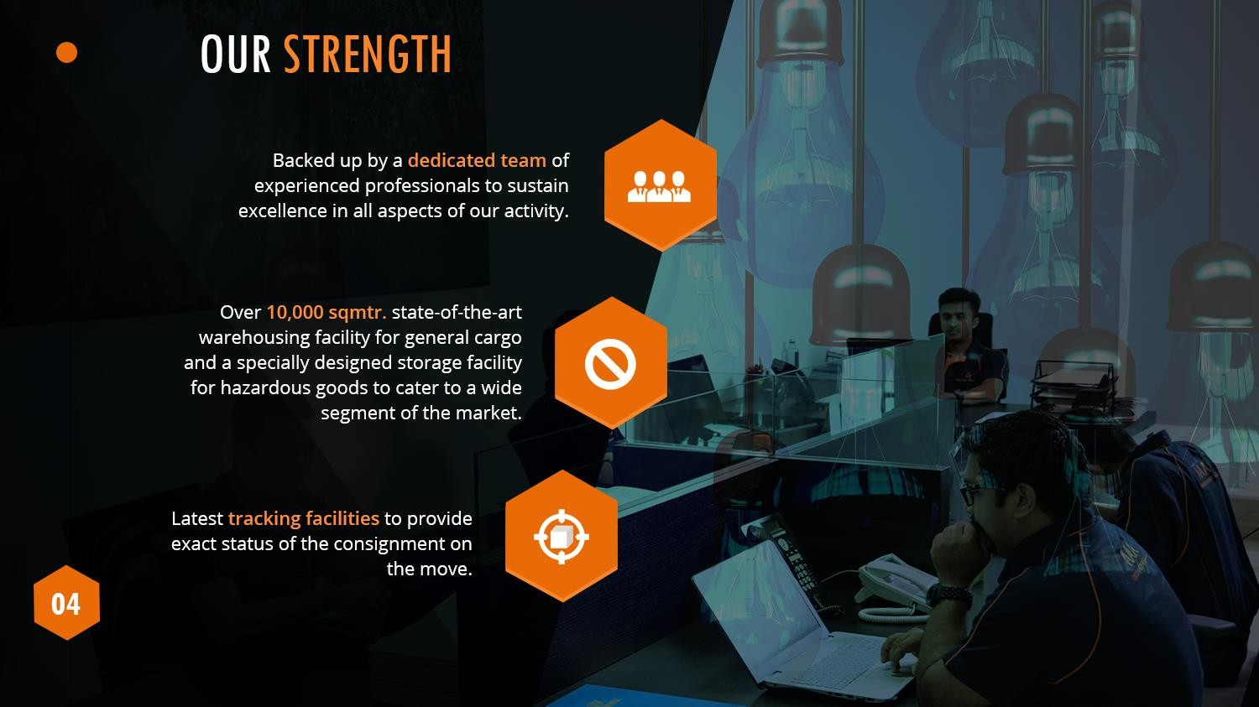

Slide 6




Slide 7
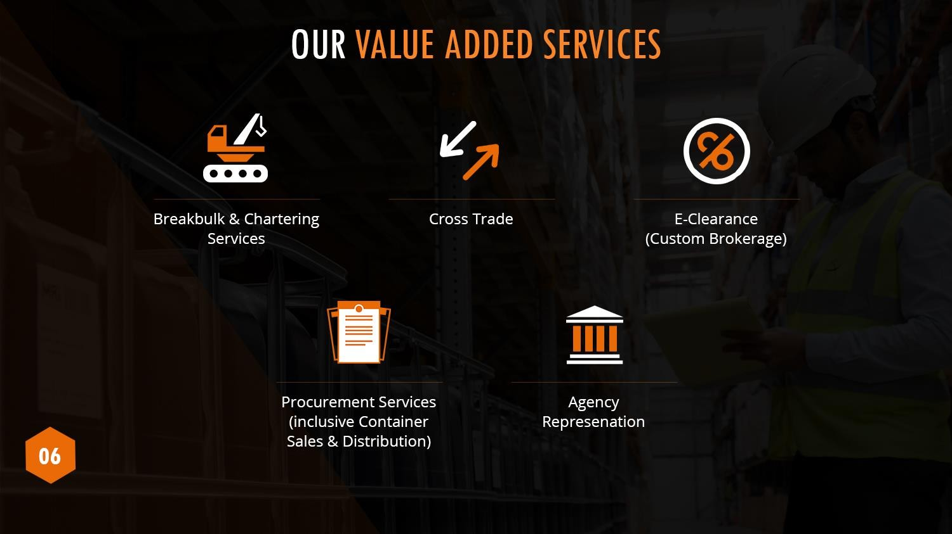

Slide 8
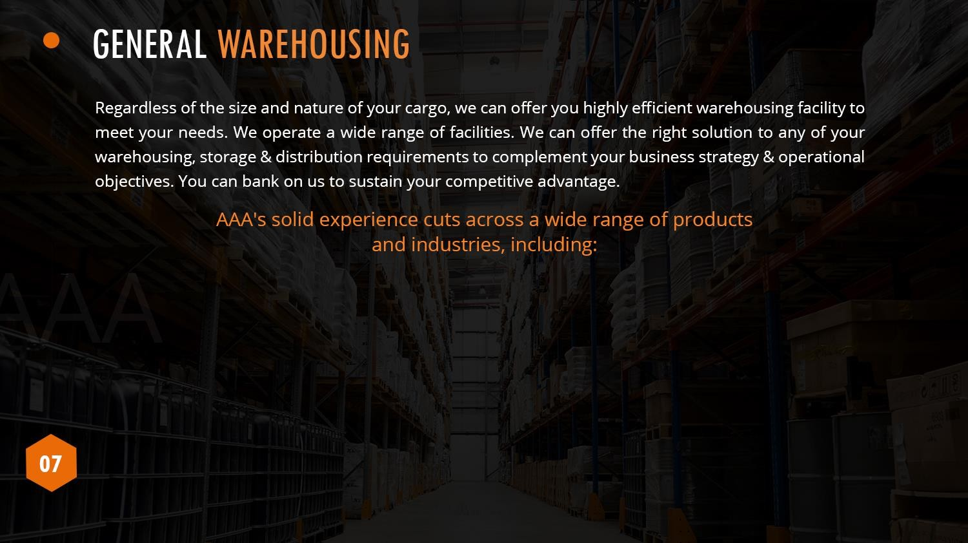
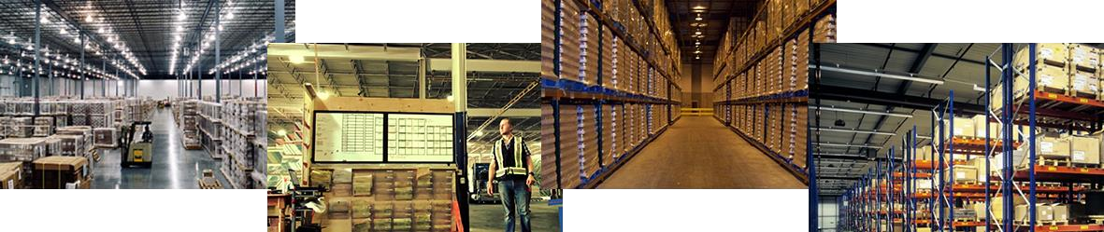
FMCG (Fast Moving Consumer Goods)
Oil & Gas
Electronics
Spare parts
Pharmaceuticals

Slide 9
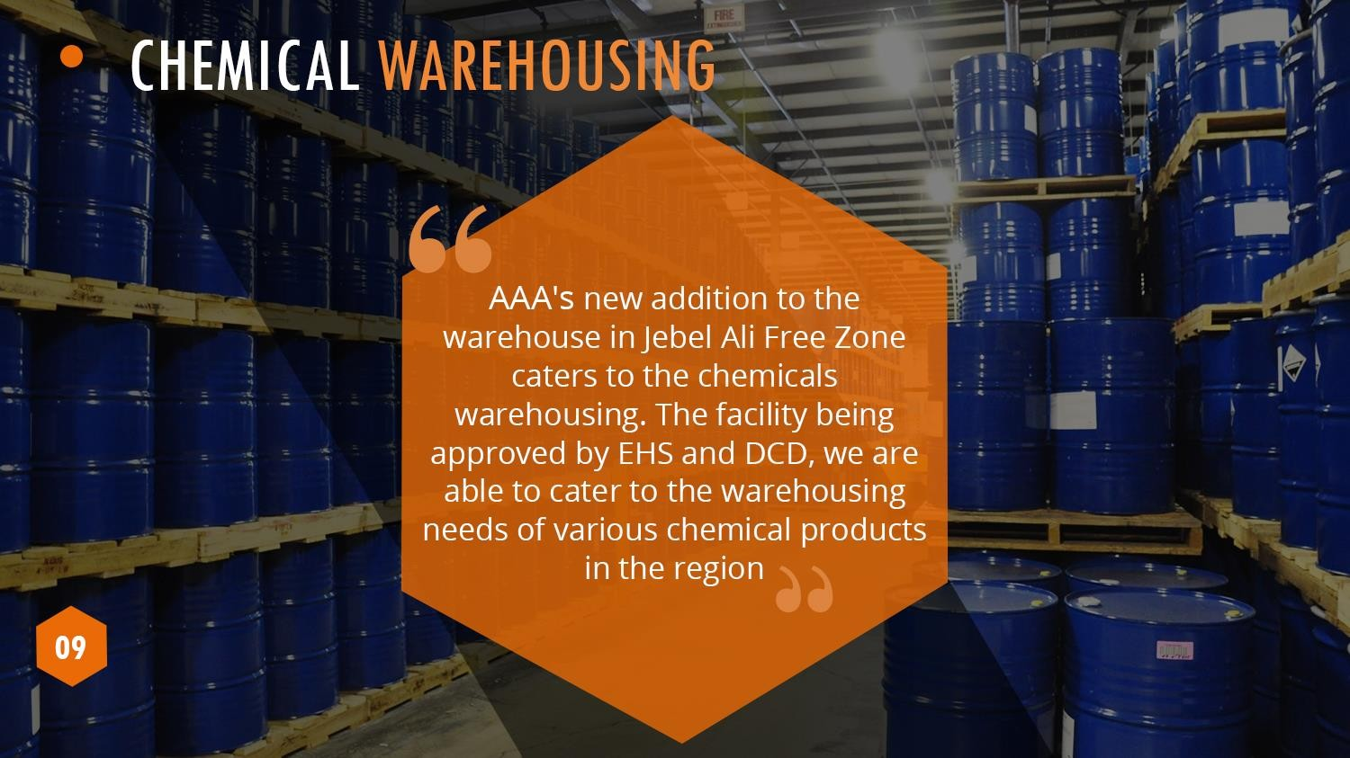

Slide 10
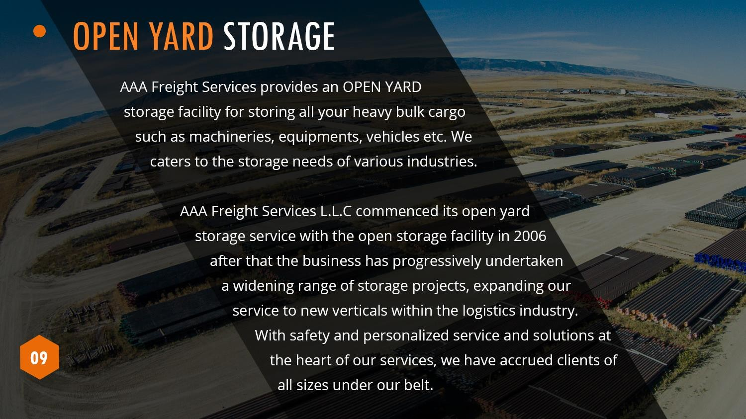

Slide 11
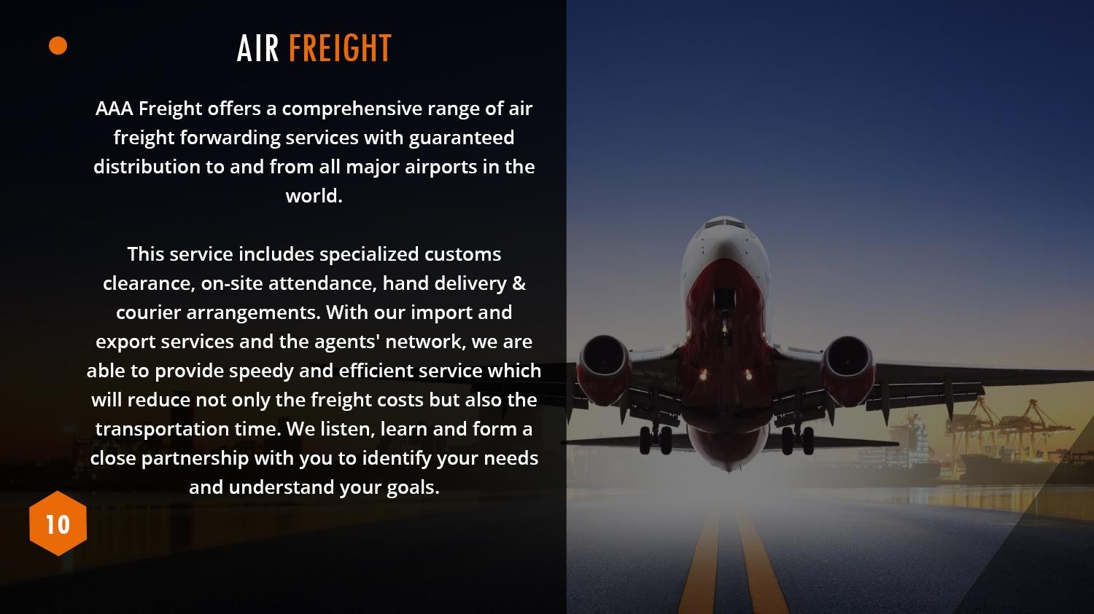
Some Of The Services
Include
•
World Wide Charter
•
Export / Import Documentation
Services
•
Door to Door Services
•
Perishables
•
Pharma & Health Care

Slide 12
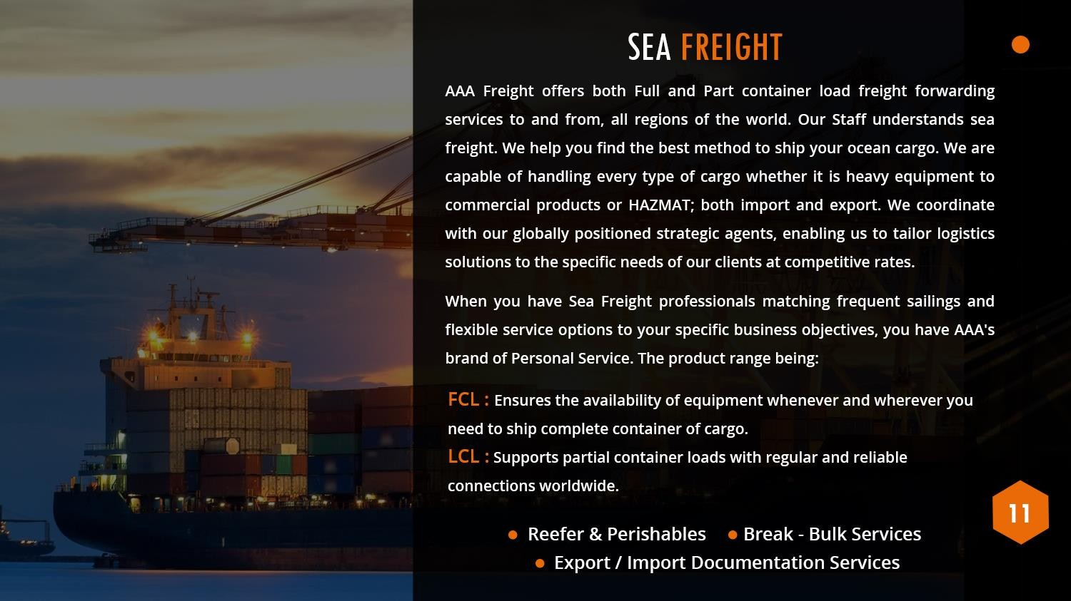

Slide 13
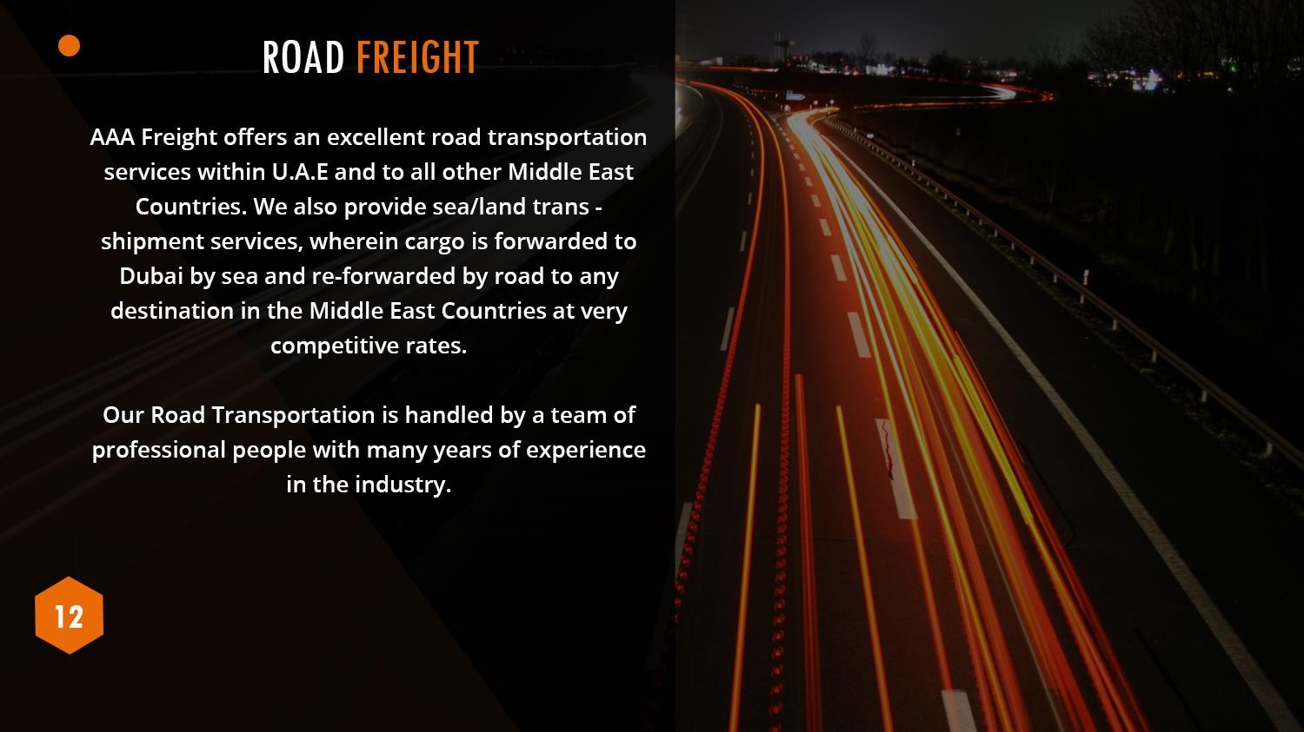
Some Of The Services
Include
Full Load & Partial Load
Door Pick-Up & Deliveries
Temperature sensitive Chemical
& hazardous Goods movements
Reefer Transportation for all type of perishable goods.

Slide 14

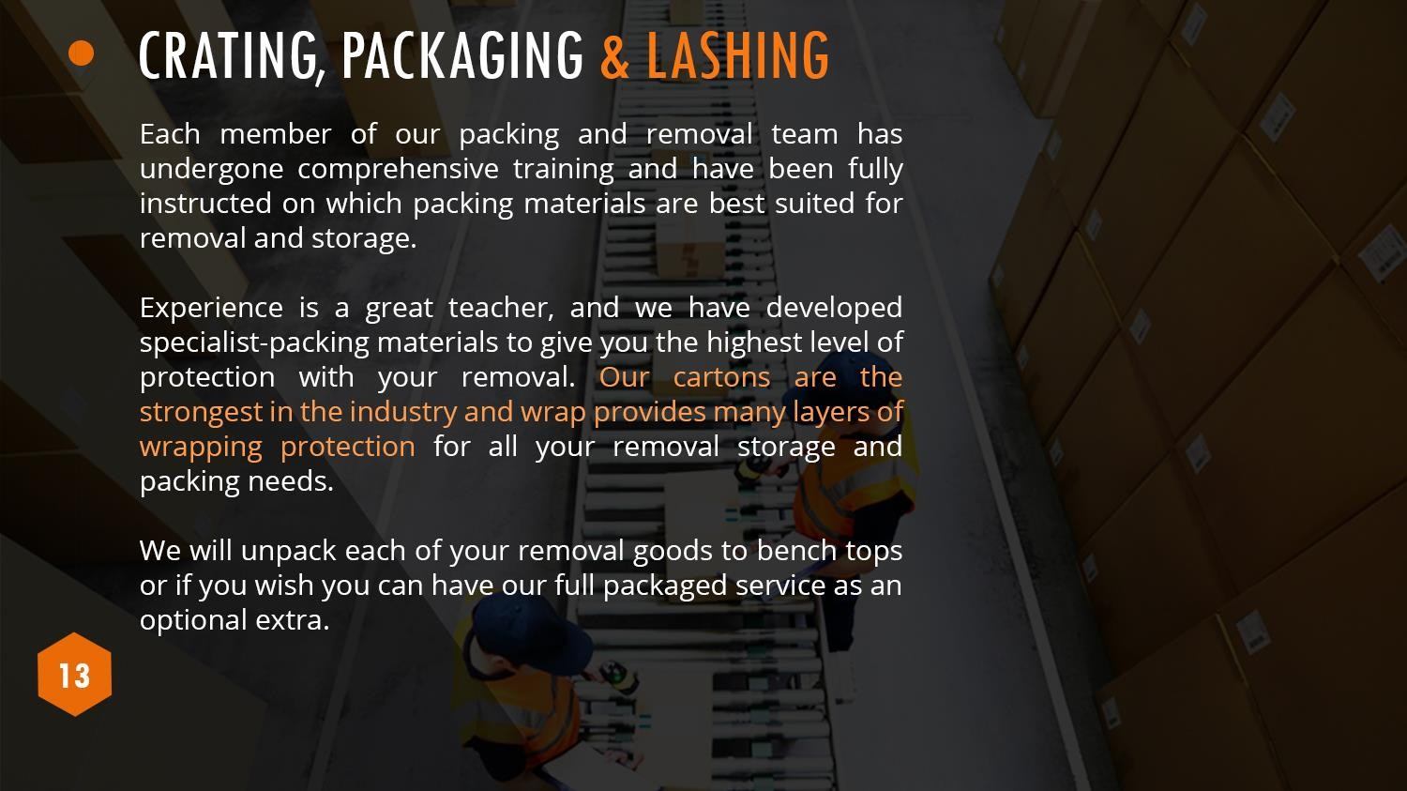

Slide 15





Slide 16



